Slide 1




GIMPAY TACK
Team Members :
Mansi Agarwal (8817103019) Ankur Agarwal (8817103010) Gaurav Bansal (8817103015)
DEPARTMENT : COMPUTER SCIENCE & ENGINEERING
SESSION – 2018 – 2019

Slide 2
PROJECT GUIDE
Er. Gaurav Raj
DEPARTMENT OF COMPUTER SCIENCE & ENGINEERING

Slide 3
Objective
The purpose of this application will be to keep track of the location and payroll of the jobholders.

Slide 4
Introduction
USer Role
When the user logins to the system, the image will be captured and will be shared via WhatsApp.
After Login,the user will send the location on receiving the notifications in a time duration of one hour.

Slide 5
Introduction (contd.)
Admin Role
Admin does his login.
He views the location updates on backendless map.
He will get the location updates via marks on google maps located on backendless geo location.
After viewing the location status he updates the payment of particular employee.

Slide 6
SCOPE OF THE PROJECT
To prevent proxy attendance which may be marked by employees.
Applicable in the fields where distribution of salary is based on location.

Slide 7
Tools and Techniques
Firebase Realtime Database
Firebase Authentication
Backendless
Adobe XD

Slide 8
Hardware and Software used
Hardware Used:
8GB RAM
Intel Core I5/Windows OS.
Software Used:
Microsoft window 7/8/10(32 or 64 bit).
Android Studio.
Java version-java development kit(JDK).

Slide 9
USE CASE DIAGRAM
Login
Share Image
Receive Image Via Whatsapp
Get Notifications
Share Location
See Location Updates
User
Admin
Update Payment

Slide 10
Data flow diagram
User
Admin
Log In
Click Image
Receive Image
Share image
See Location Updates
ON GPS
Update Payment
Get notifications
Share Location
Log Out

Slide 11
IMPLEMENTATION
The system developed by us includes following modules as follows:
Login Page
Firebase authentication with login page
On GPS
Firebase database for payment update

Slide 12

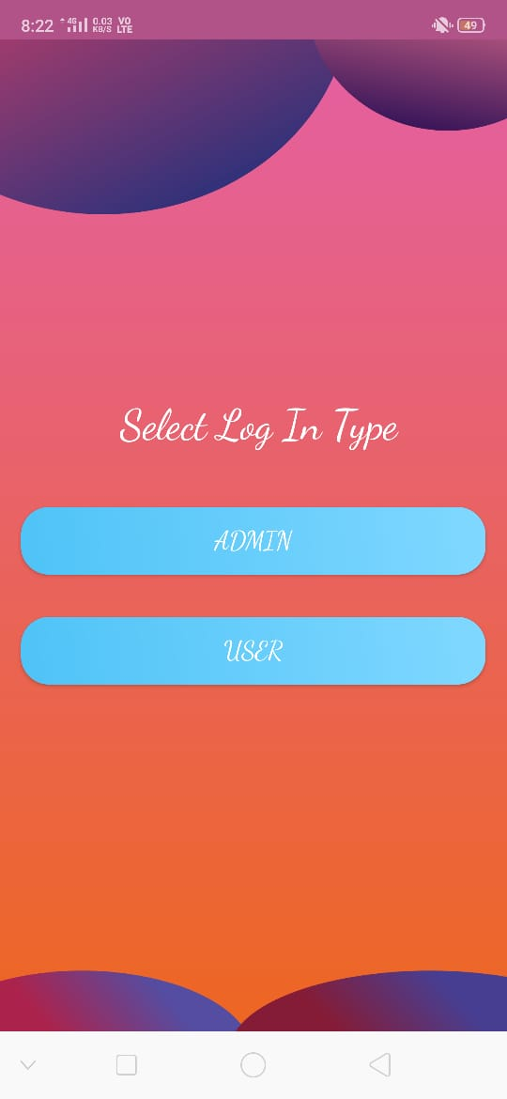
Work Demo

Slide 13
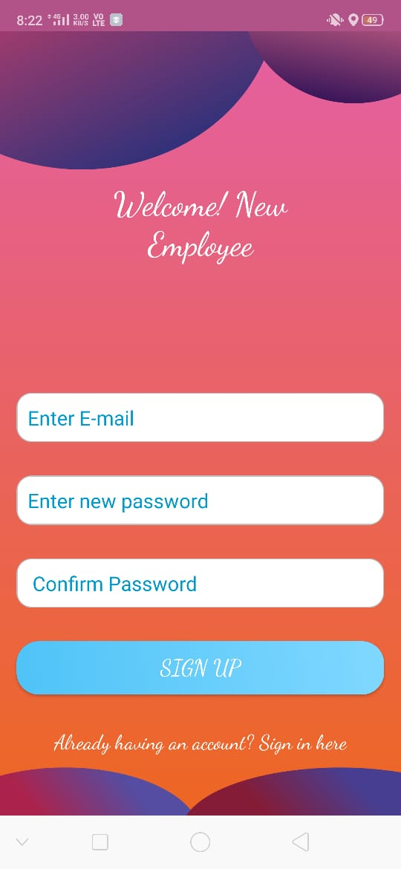
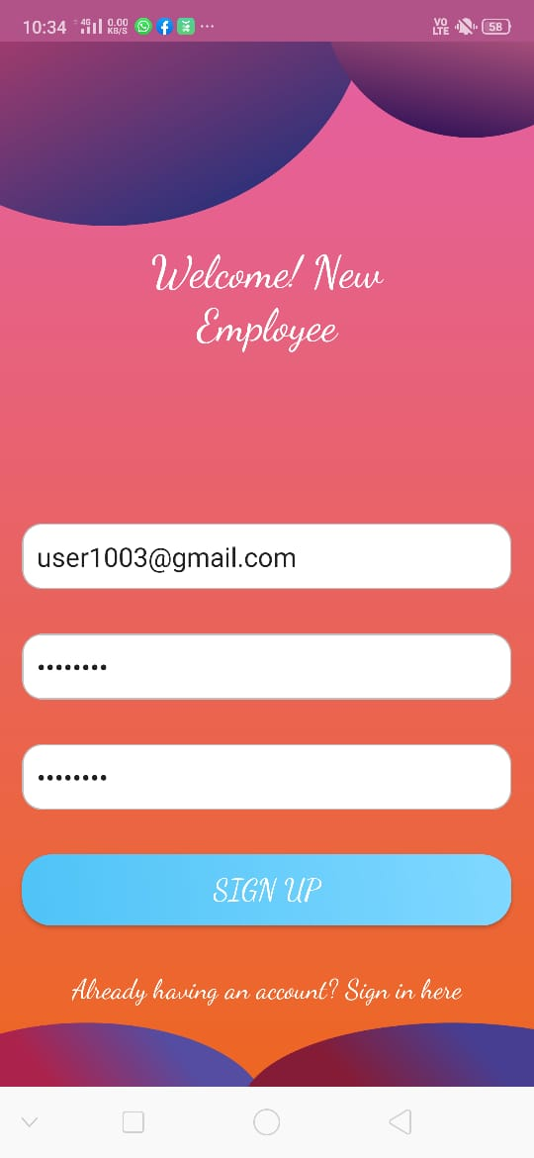
New User Registration

Slide 14
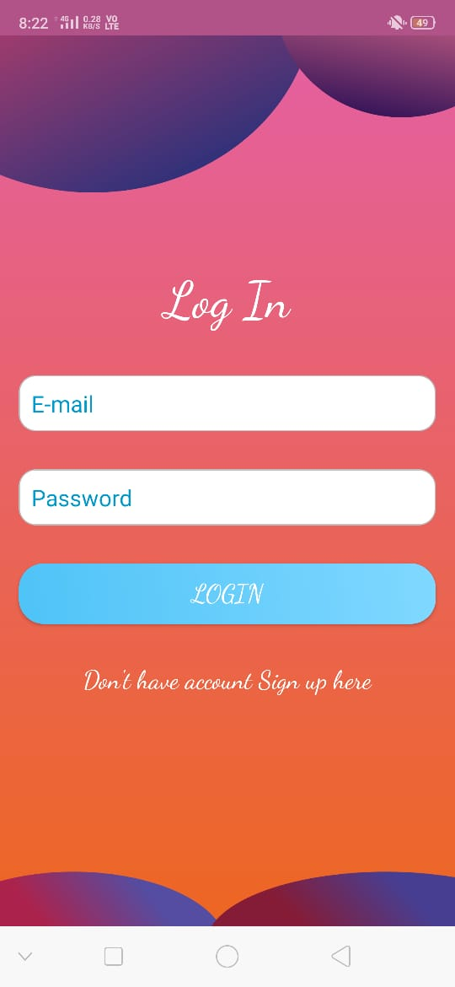
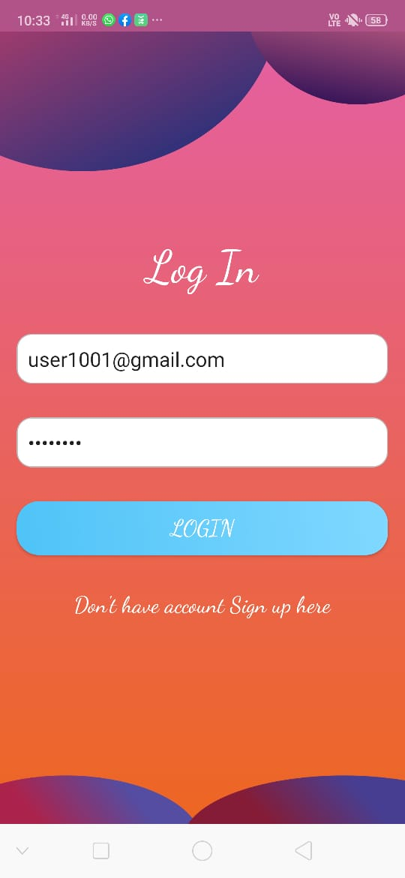
User Login

Slide 15
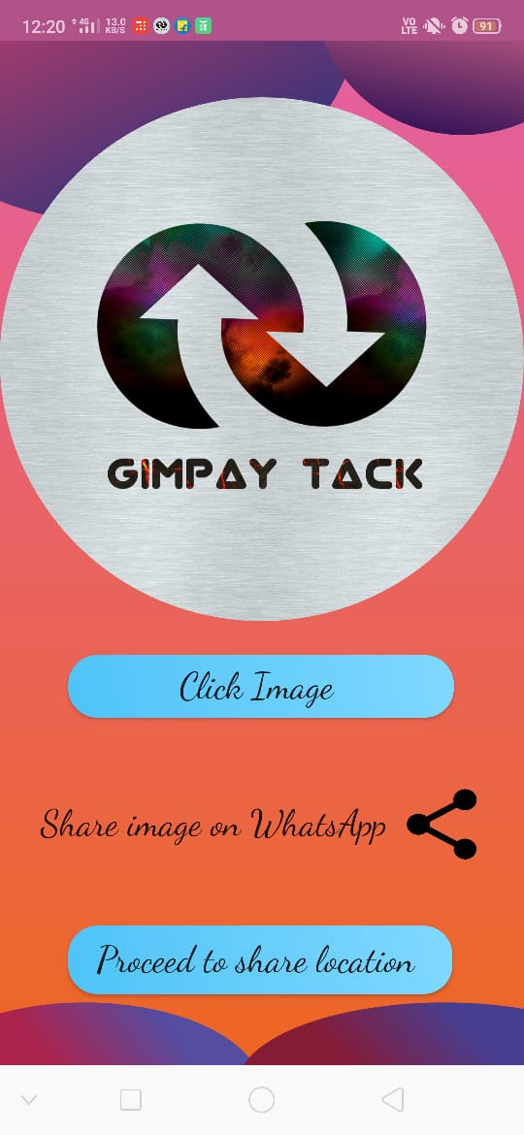
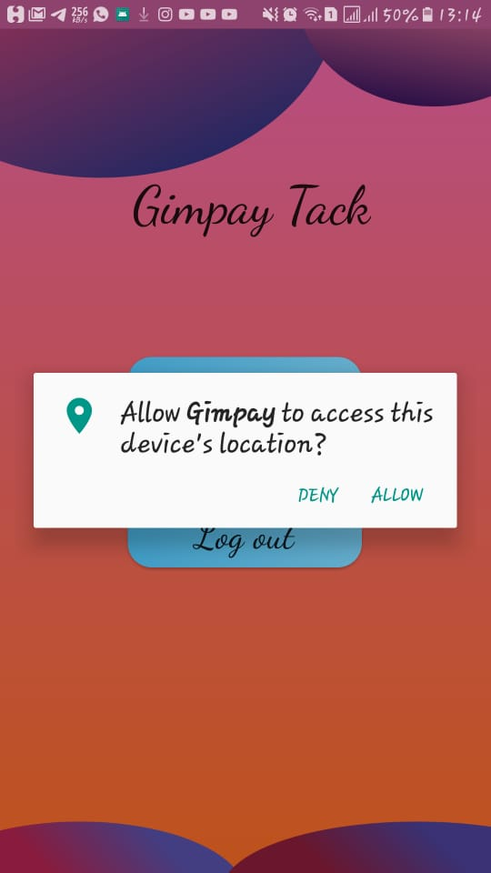
Share image & location

Slide 16
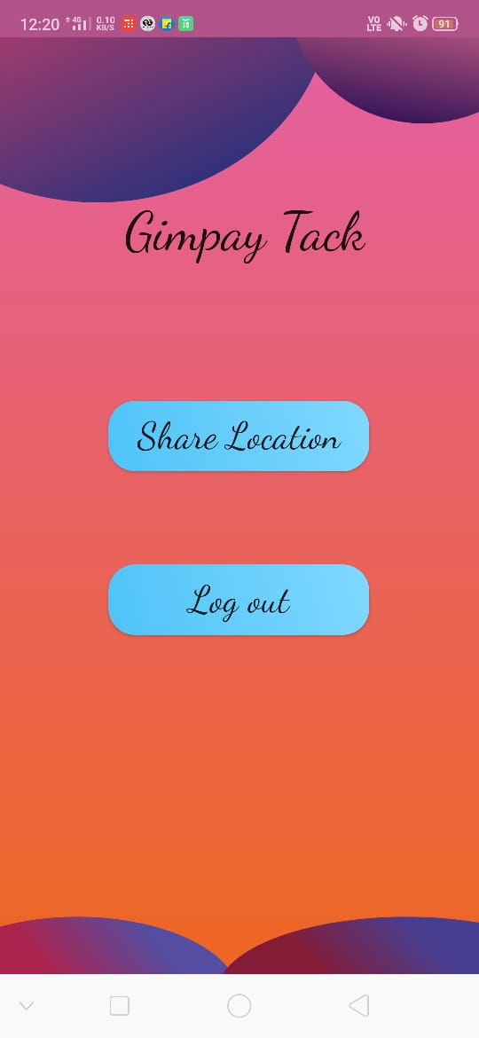
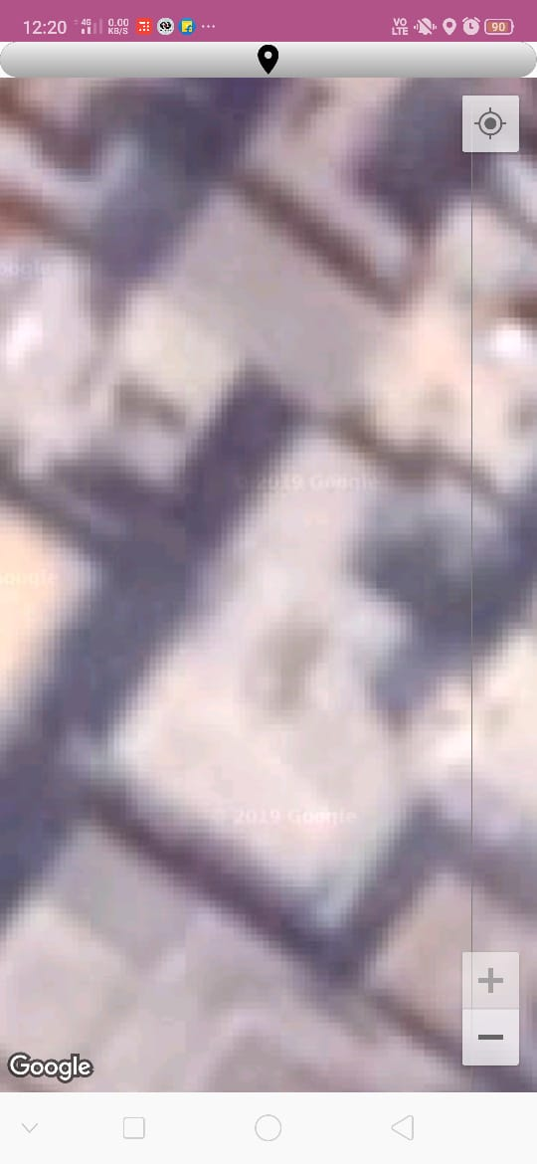
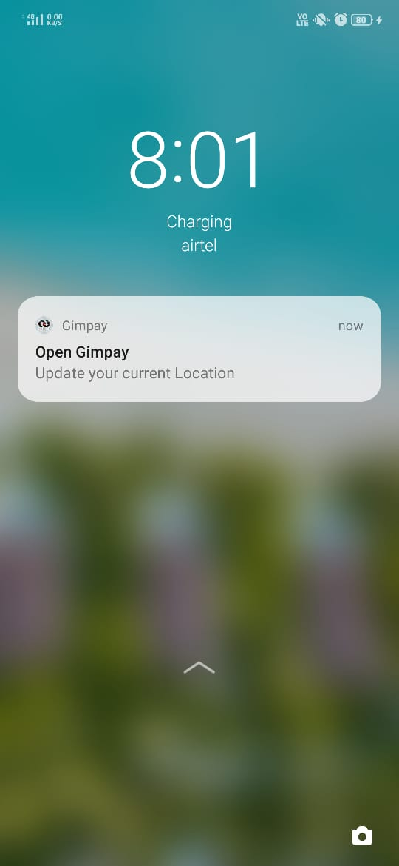
Logout functionality

Slide 17
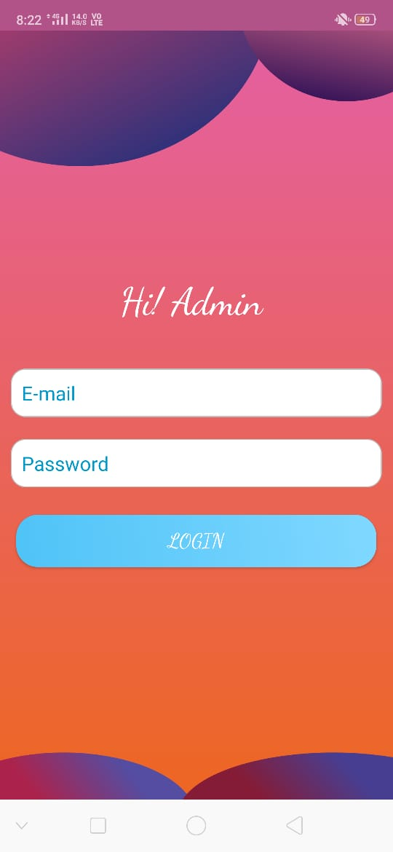

Admin login

Slide 18
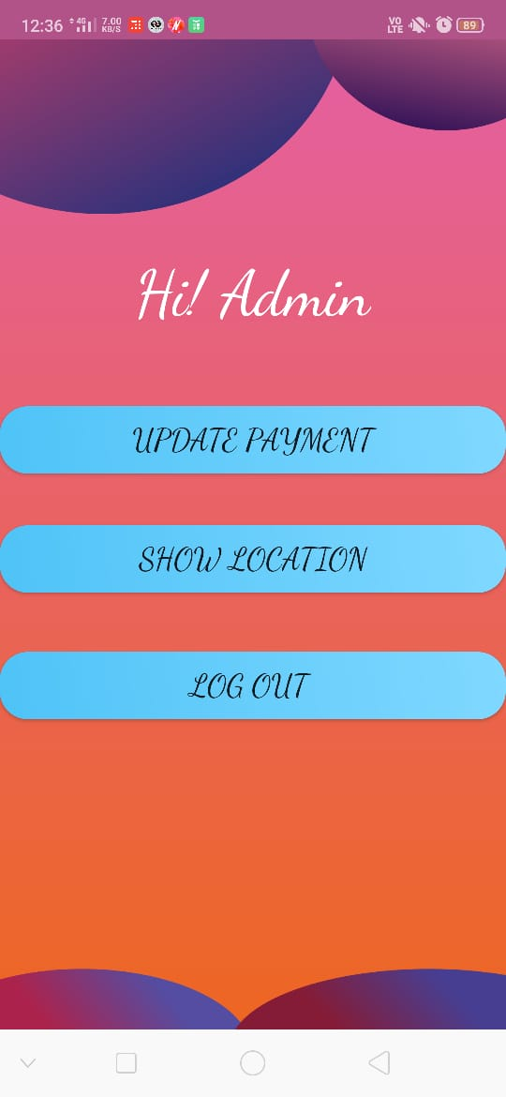
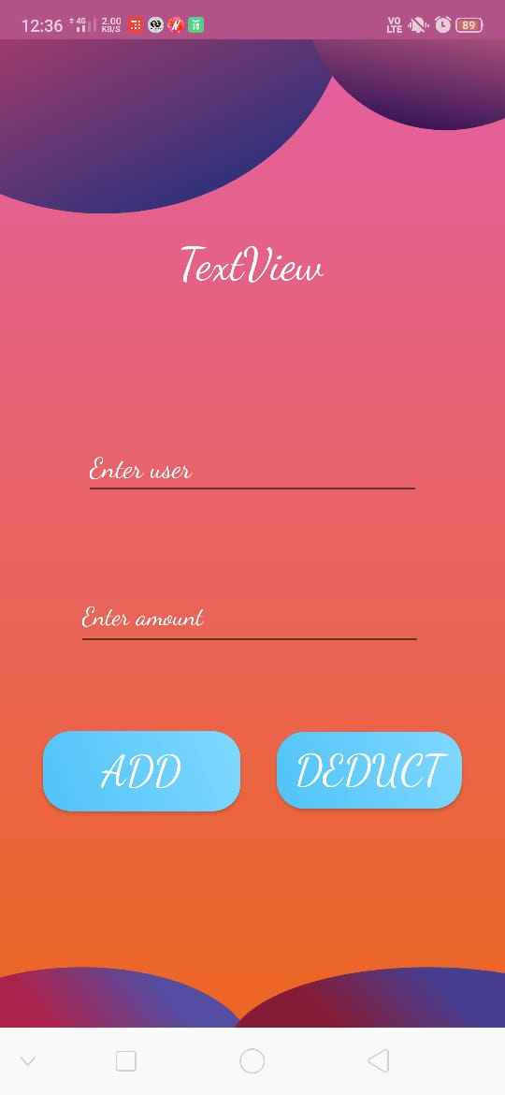
Admin task

Slide 19
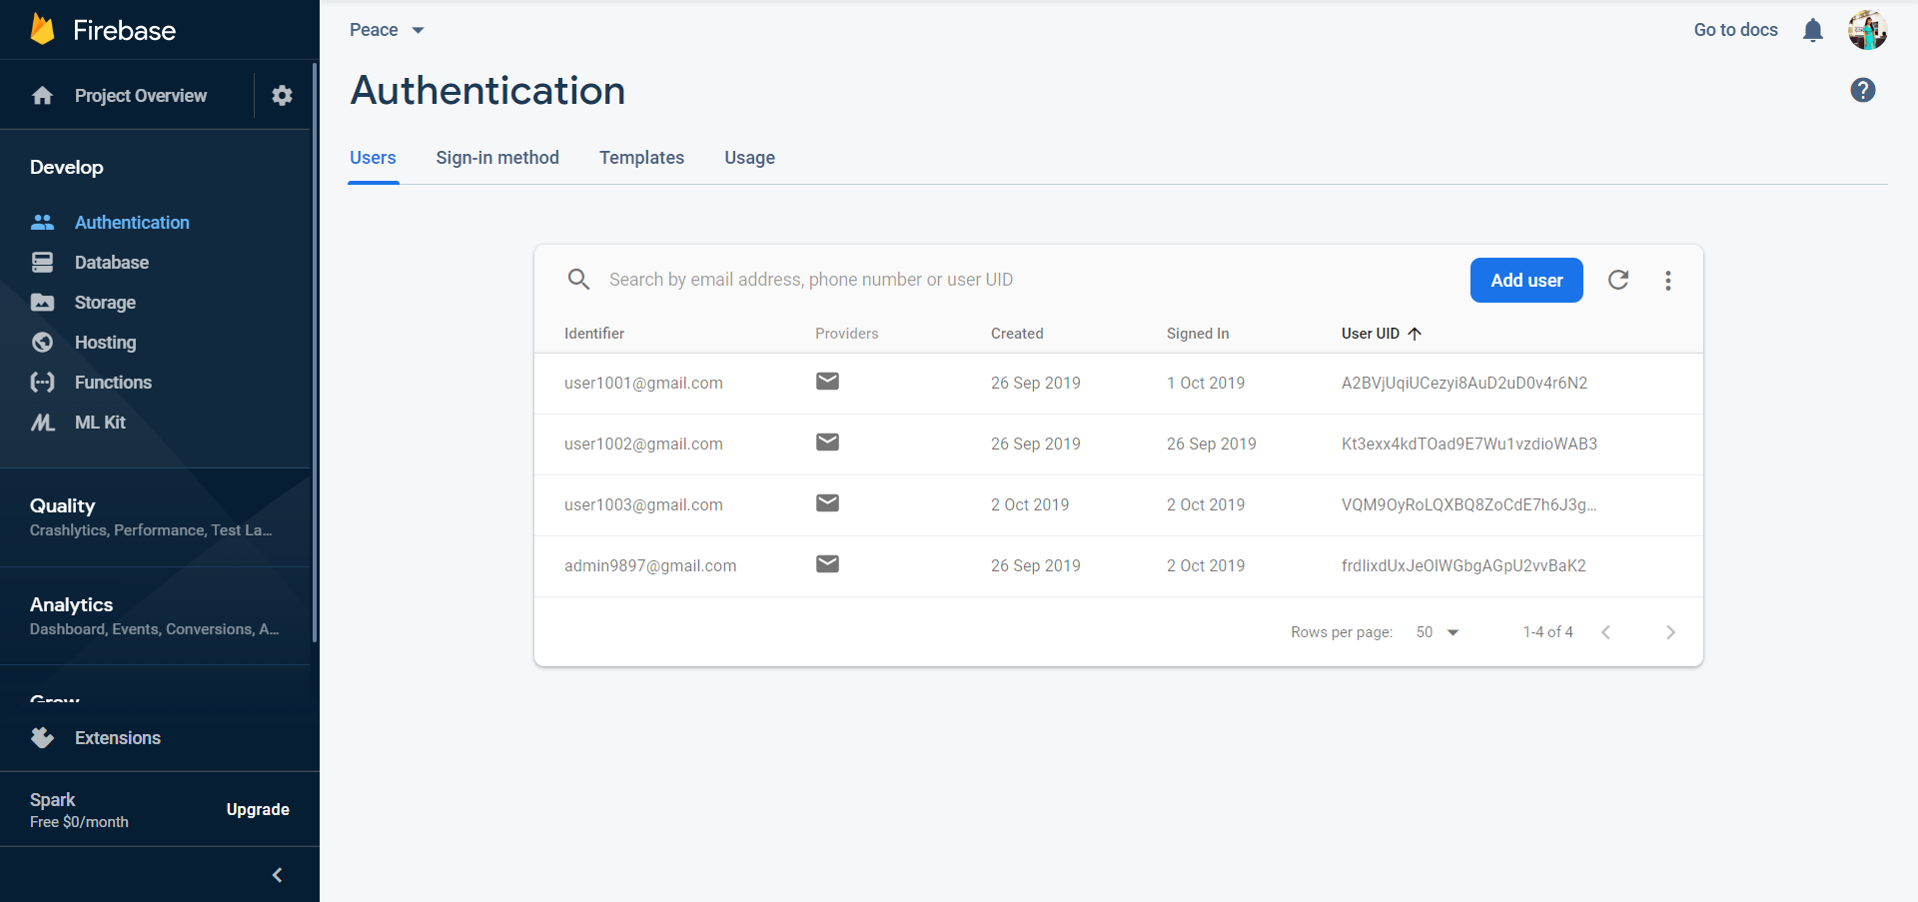
DATABASE AUTHETICATION PAGE

Slide 20
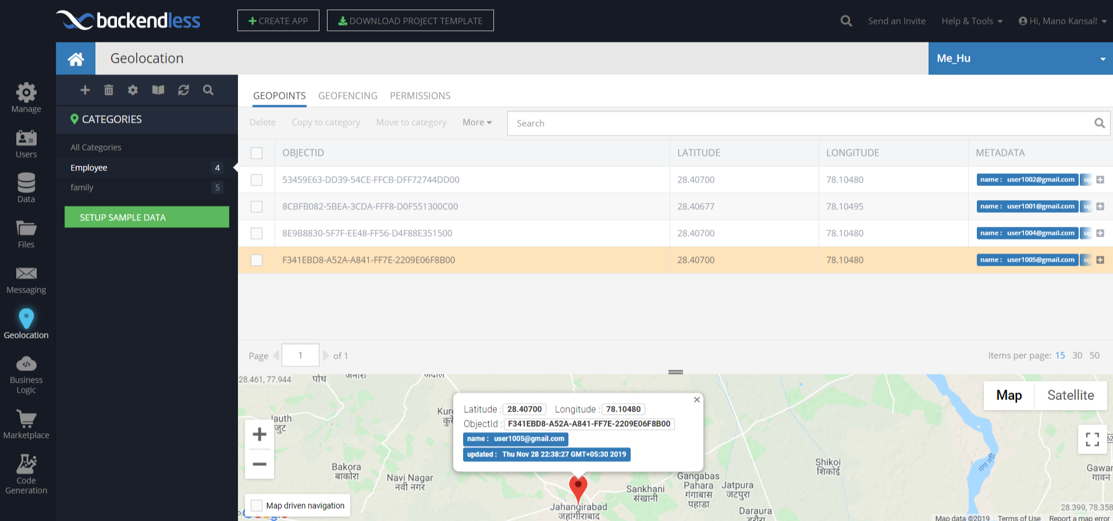
Backendless server

Slide 21
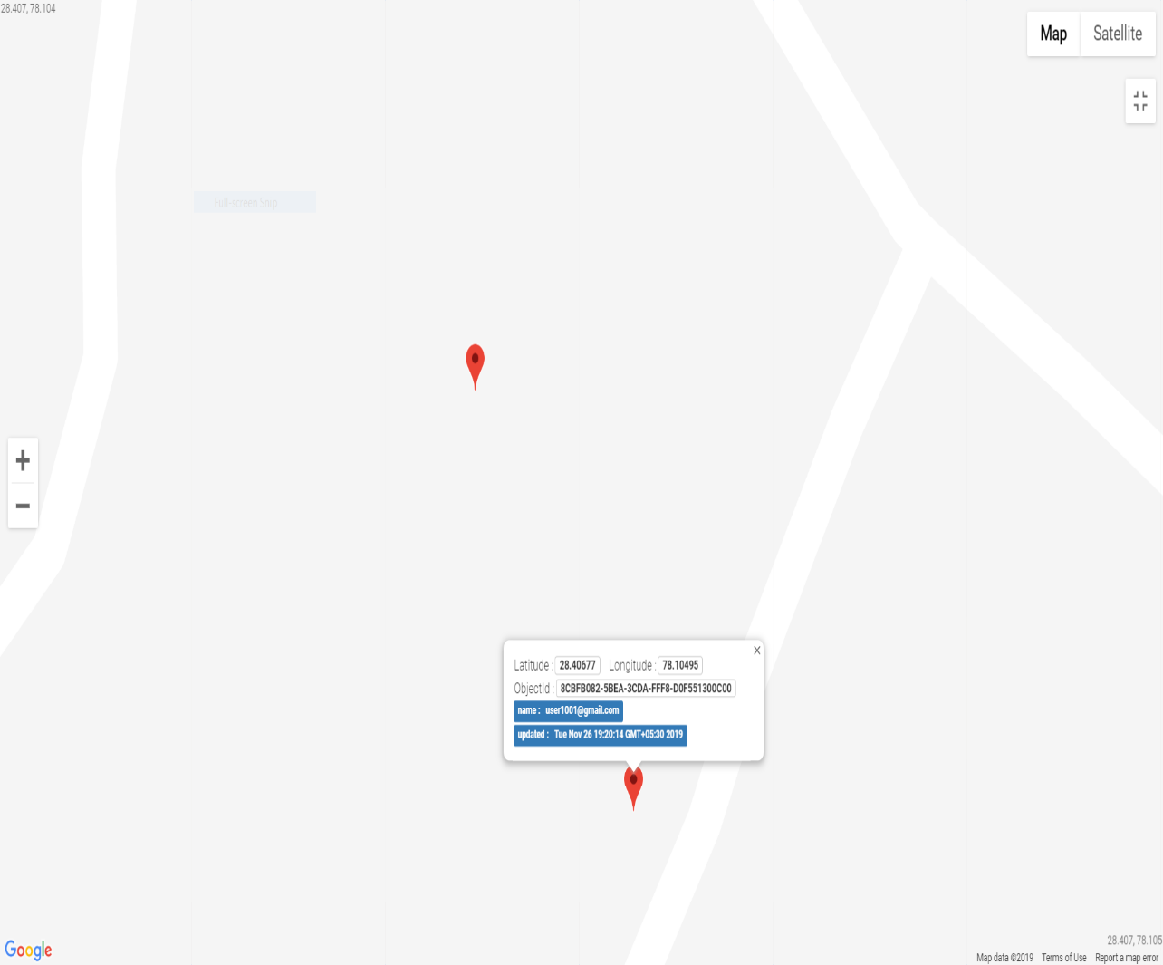
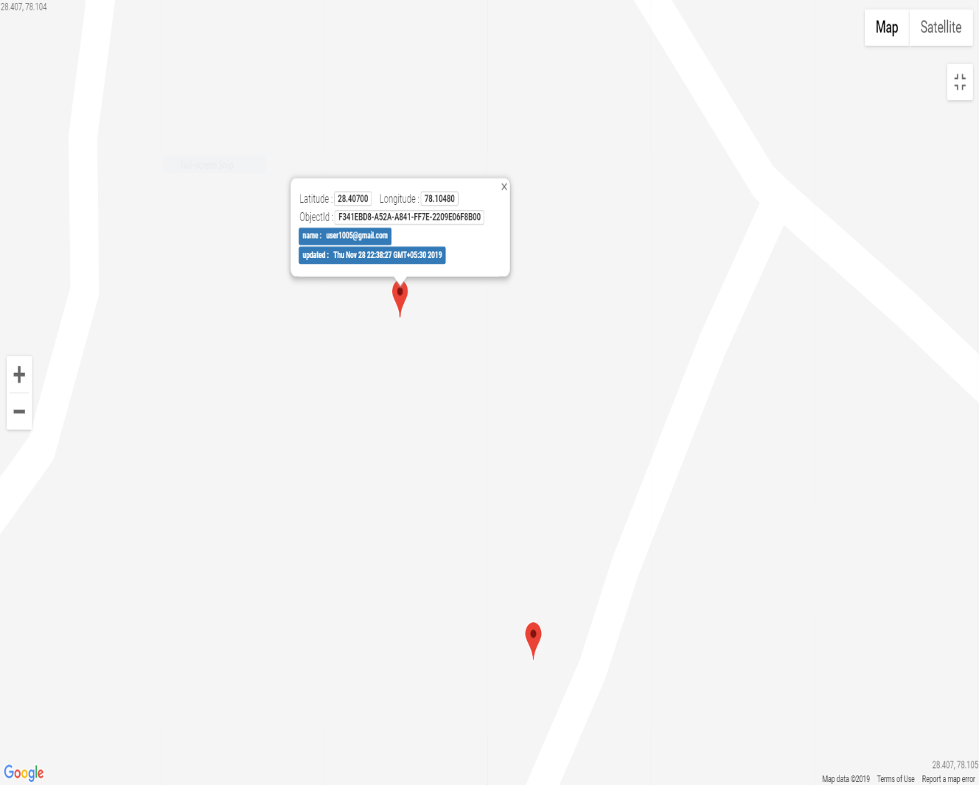
Location of different users
User1001
User1002

Slide 22
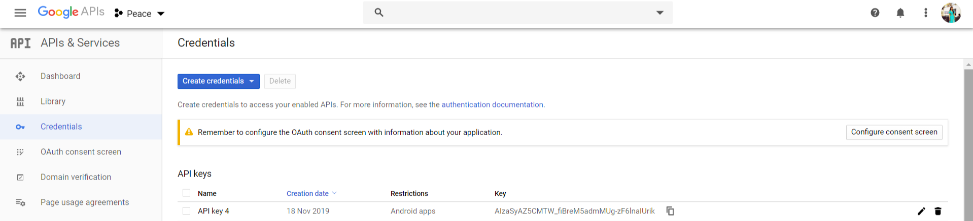
Google maps api key

Slide 23
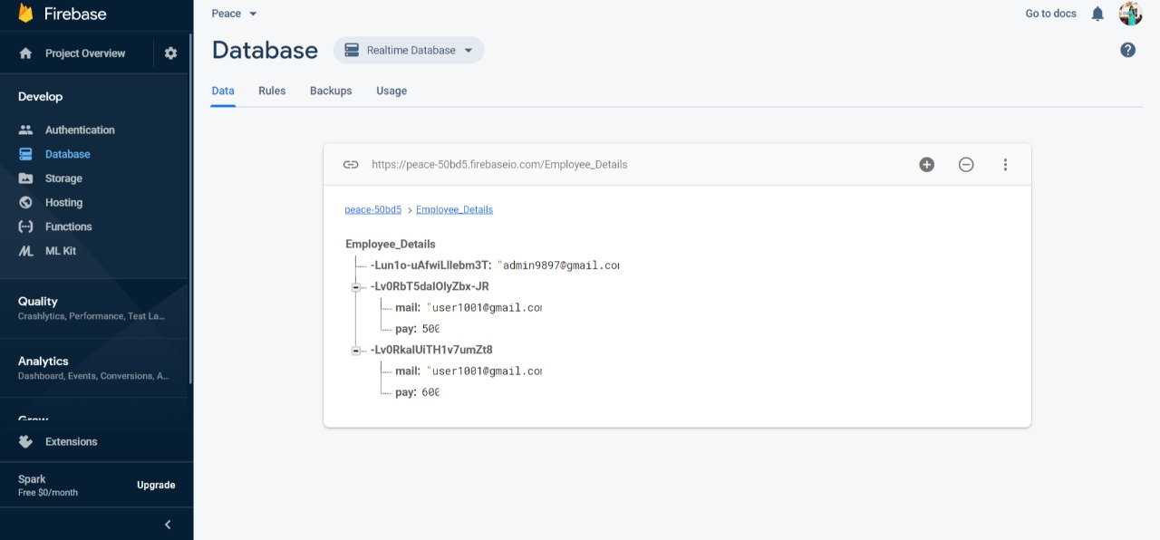
updation of payment
add payment

Slide 24
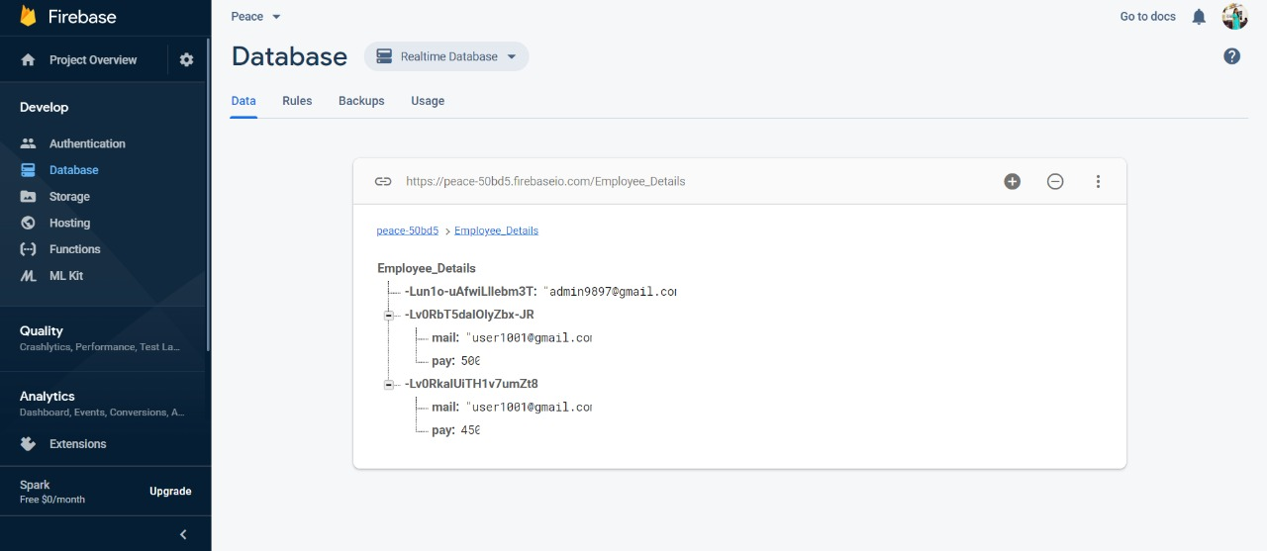
updation of payment
Deduct payment

Slide 25
Advantages
This System helps the admin to keep track of the employee’s who go for field work .
Since GPS location of the employee is tracked, so employee will not attempt to add proxy attendance.

Slide 26
Limitations
All employees must have an android phone to use this application.
If camera gets corrupted at user’s side this system fails to work.
User permission includes Internet, Write to external storage, Read external storage, access coarse and fine location.

Slide 27
FUTURE SCOPE
The project can be extended to a web application which may only include HR and admin logins.
The HR may ensure that admin had honestly updated the payments of employees.
May be applicable in delivery system where the employees do part-time job and payment will be on the basis of packages delivered.

Slide 28
Thank you…

